Slide 1

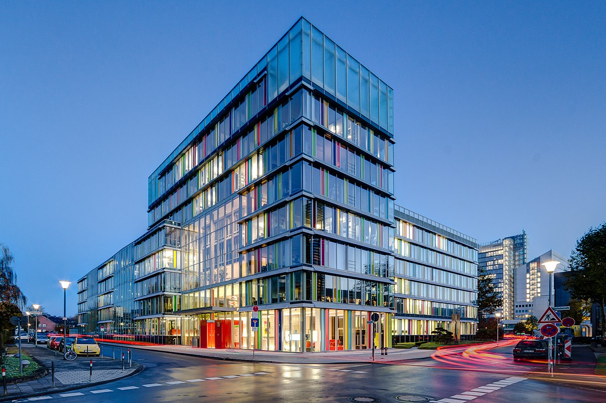
VALUATION OF
COMPANY
CDS

Slide 2
CONTENT
01
02
03
Different types of methods
Profit based value
Definition
04
05
Balance sheet value
DCF based value

Slide 3

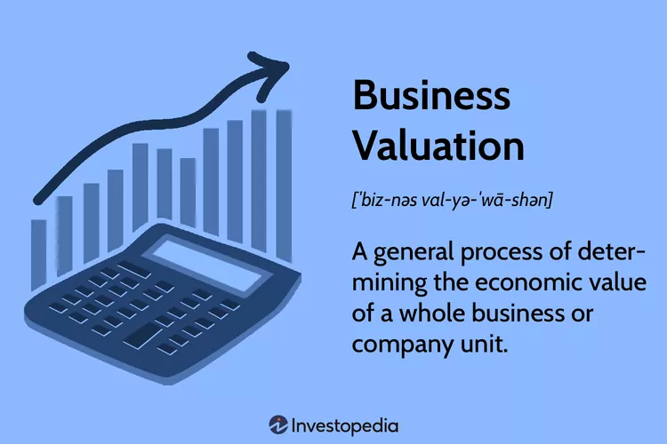
DEFINITION

Slide 4




WHY ?
TO DETERMINE THE CURRENT WORTH OF A BUSINESS
ANALYSIS OF THE COMPANY
A company is looking to merge with or acquire another company or maybe to sell all or a portion of its operations.
Looking to buy shares and want to know if the company is buying them at a good price

Slide 5

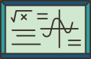

ONE SHARE
FIXED VALUE
EVOLUTIVE VALUE
Value given to a share at the creation of company
Depends on the financial situation of the company

Slide 6
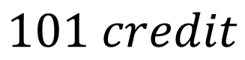
FIXED VALUE
PER VALUE OR NOMINAL VALUE
ISSUING PRICE OR PAID PRICE
Price we ask shareholders to pay
$$VN∗Nb shares=Capital share$$
ISSUING PRICE > VN
$$101 credit$$

Slide 7

EXAMPLE
Nb shares : 100
VN : 100
IP : 120
Share capital : 100shares * 100 = 10,000
Credit 101
Bank : 100shares * 120 = 12,000
Debit 512/456
To get balance => ISSUING PREMIUM : (120-100)* 100shares = 200 premium
Credit 104
* Issuing premium : gab between VN and IP

Slide 8
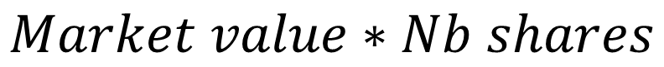
EVOLUTIVE VALUE
DYNAMIC VALUE OR STOCK EXHANGE
CURRENT OR MARKET VALUE
Calculating on bases of profit and asset
$$Market value∗Nb shares$$

Slide 9
CURRENT OR MARKET VALUE
DIVIDEND BASED VALUE
NET ASSET BASED VALUE
Calculated on the profit
Calculated on the bases of asset or heritage

Slide 10

DIFFERENT TYPES OF METHODS
PROFIT BASED VALUE
MARKET VALUE
DCF VALUE
Based of the calculation of the value of the company from the balance sheet
Based on profitability of the company
Based on projections of future cash flows

Slide 11



PROFIT BASED VALUE
Based on the profitability of the company
Income distributed : FINANCIAL VALUE ( FV)
Income generated : RETURN VALUE ( RV)
VR = $\frac{D+r}{i}$
FV = $\frac{D}{i}$
r = $\frac{R}{N}$
D : dividend distributed during the financial year
r : share of reserves attached to a security
R : retained earnings
i : rate that would produce interest equal to the income from the share
N : number of shares
Notes:
Financial value is the money we have to invest at a certain rate t% of loan so that we can get an interest exactly inquire to the dividend. So if you want to know the money to invest : (formule)
Return value is the money we have to invest t a certain rate t% of loan so that the revenue is equal to the dividend + reserve

Slide 12
MARKET VALUE
Market value = current value = net asset based value
Mathematical value or book value
Intrinsic value
Liquidation value

Slide 13



MARKET VALUE
1) ANC = Real asset - Liabilities
2) ANC = Equity – fictitious asset
We can calculate the 3 kinds
$$VMT= \frac{ANC}{Nb shares}$$
$$VMI= \frac{ANC+gain −loss}{Nb shares}$$
LV$= \frac{ANC−loss}{Nb shares}$
Notes:
VMT : mathematical theorical value VMI : mathematical intrinsic value
Loss : result from revaluation of asset and liabilities
Real assets are tangible assets that have intrinsic value because of their physical properties or utility. Like land, buildings, inventory, tools, machinery,
Fictitious assets are non-physical assets that do not have intrinsic value but represent a future benefit to the company like fees, legal expenses ,,,

Slide 14

DISCOUNTED CASH FLOW BASED VALUE (DCF)
Focused on determining the present value of future cash flows.
$$DCF={\left(\frac{CF1}{1+r }\right)}^{1}+{\left(\frac{CF2}{1+r}\right)}^{2}+ ,,, +{\left(\frac{CFn}{1+r}\right)}^{n}$$
CFi : cash flow period i
r : interest rate
n : time in years before the future cash flow occurs

Slide 15
Thank's for your attention

